Slide 1

AGRIWISE : SMART CROP ADVISOR USING SOIL & WHEATHER INTELLIGENCE
Empowering Small Farm Holders for Sustainable Agriculture

Slide 2




The Challenge: Traditional Farming Limitations
Reliance on Intuition
Suboptimal Crop Choices
Farmers often use age-old practices, lacking scientific backing.
Leads to lower yields and wasted resources.
Inefficient Fertilizer Use
Vulnerability
Can harm soil, increase costs, and impact environment.
Small farmers are highly susceptible to climate change and market fluctuations.

Slide 3
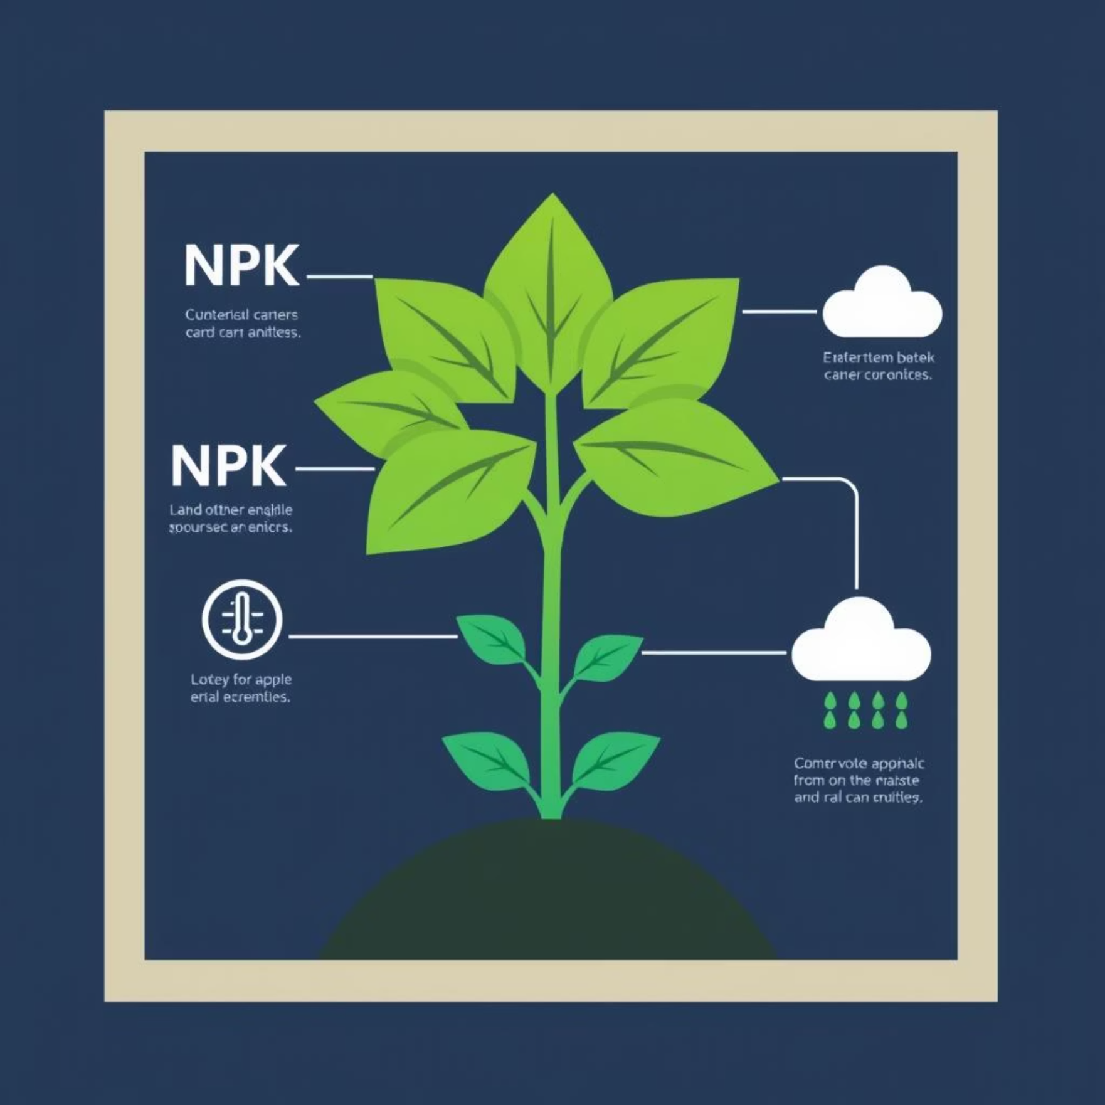
Our Solution: A Data-Driven Crop Advisory System
A system recommending the most suitable crop and fertilizer advisory based on key parameters:
Soil Macronutrients: Nitrogen (N), Phosphorus (P), Potassium (K)
Soil pH Level
Environmental Data: Temperature, Humidity, Rainfall
Core Objectives:
Provide Accurate Crop Suggestions.
Offer Precise Fertilizer Advisory.
Empower Farmers with scientific decision-making.
Optimize Resource Utilization.

Slide 4




System Architecture: How It Works
Data Acquisition Layer
Data Preprocessing & Storage
Simulated Soil Parameters (N, P, K, pH) & Environmental Data (Temp, Humidity, Rainfall).
Data Cleaning & Normalization, Database (Historical Data, Crop Requirements).
Core Recommendation Engine
User Interface (UI)
Crop Recommendation Module (ML Model) & Fertilizer Advisory Module (Rule-Based System).
Input Interface & Recommendation Display (Prototype: Simple Web/CLI).

Slide 5
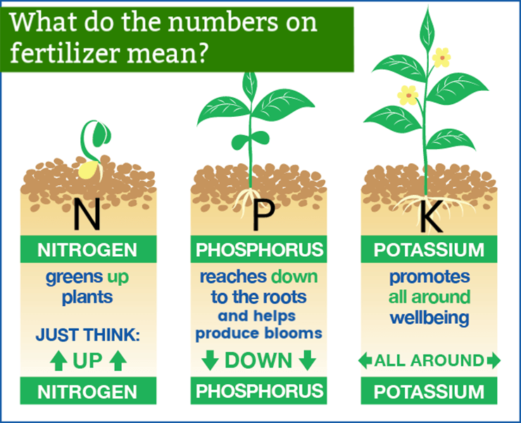
Data & Methodology: Crop Recommendation
Data Source:
Kaggle Dataset (Crop_recommendation.csv)
Features: N, P, K, Temp, Humidity, pH, Rainfall
Target: Crop Name (label)
Methodology Steps:
Machine Learning Model
Data Preparation
Random Forest Classifier training and hyperparameter tuning.
Exploratory Data Analysis (EDA)
Cleaning, scaling, and splitting into training/testing sets.
Understand data distributions and correlations.

Slide 6

Fertilizer Advisory: Optimizing Nutrient Use
Purpose: To suggest the optimal type and quantity of fertilizer.
Approach: Rule-Based System
Compares current soil N, P, K levels with ideal ranges for the recommended crop.
Requirements: A comprehensive database of optimal NPK ranges for various crops and corresponding fertilizer types.

Slide 7
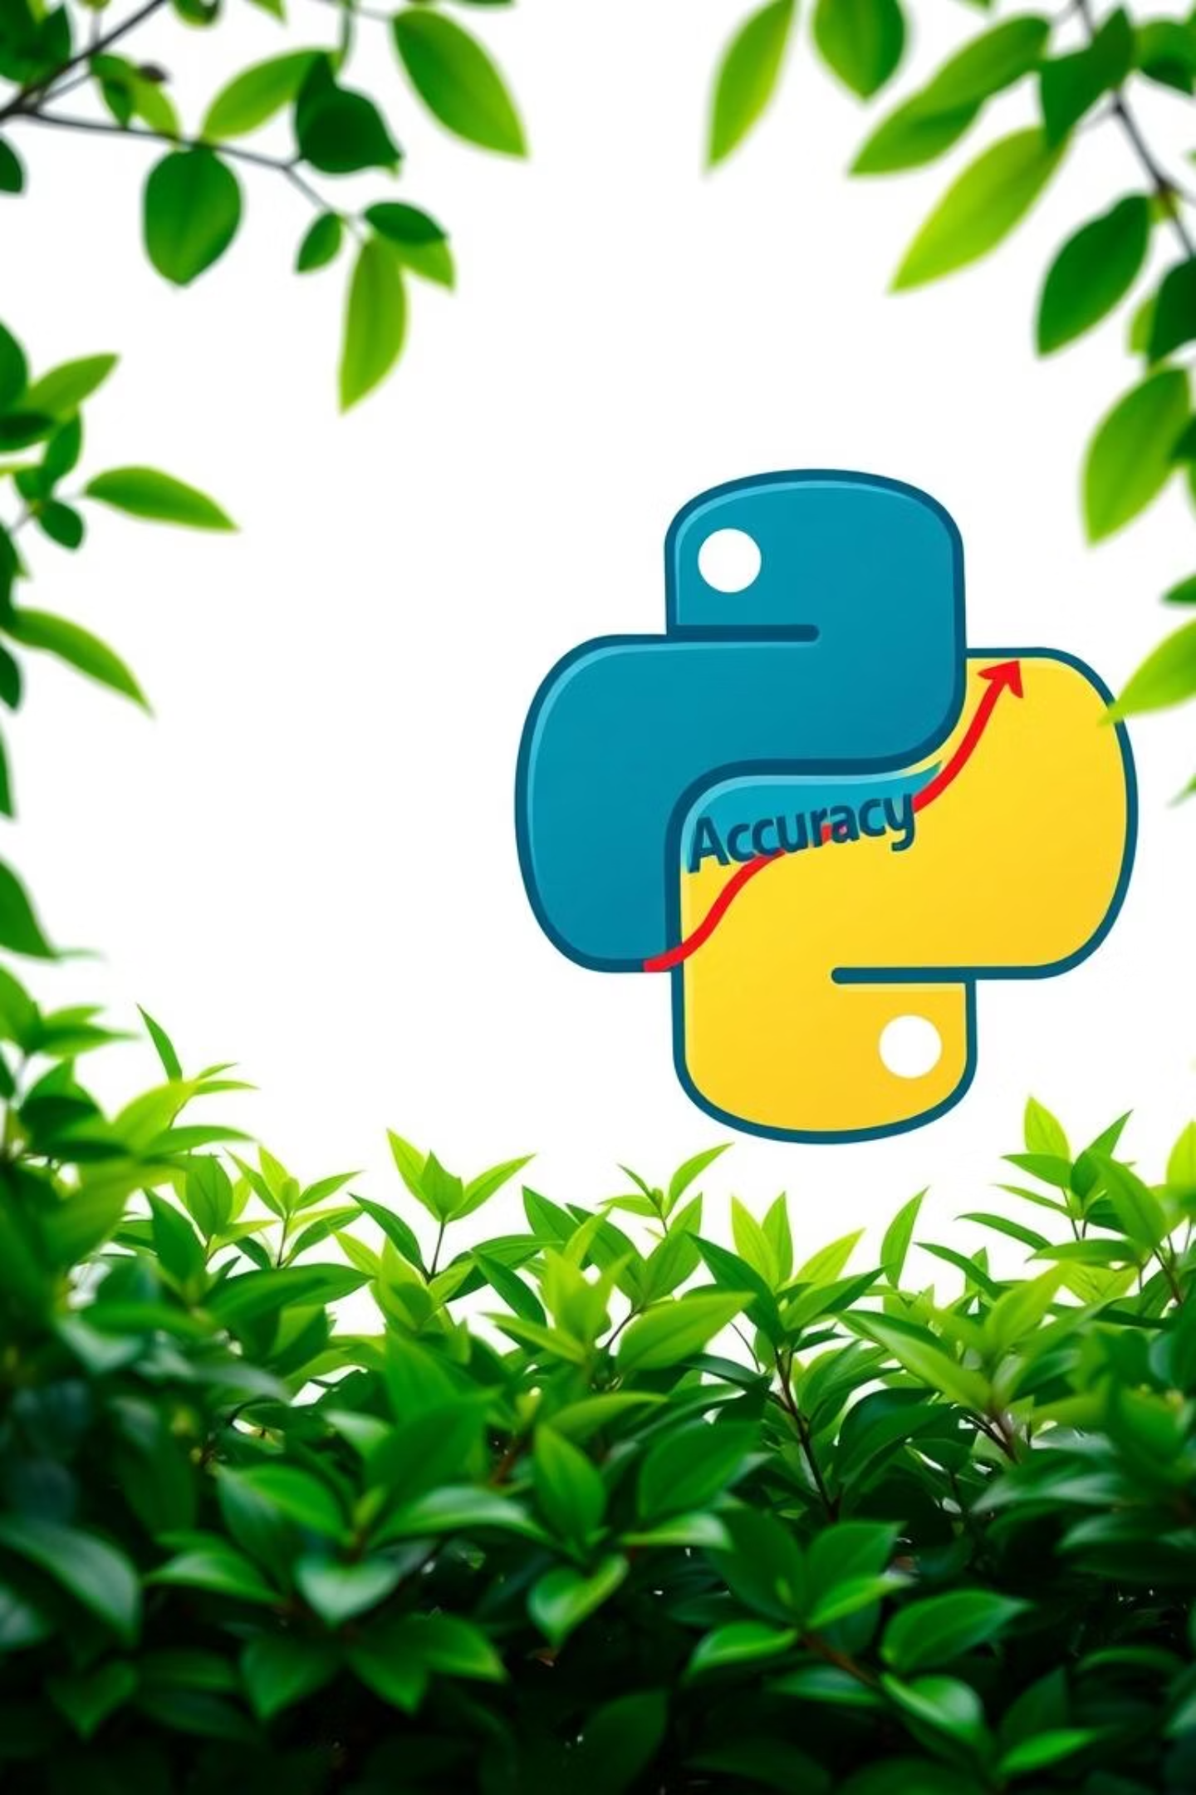
Implementation & Performance Evaluation
Implementation (Prototype):
System Evaluation:
Programming Language: Python
Crop Recommendation Model: Metrics: Accuracy, Precision. Analysis: Confusion Matrix.
Key Libraries: pandas, numpy, scikit-learn, matplotlib, seaborn.
Fertilizer Advisory: Qualitative review against established agricultural best practices.
Deployment: React js , ML , node js , pre existing data about crops.

Slide 8






Transformative Impact for Farmers
Empowers Farmers
Optimized Resource Use
Scientific backing for crucial decisions.
Efficient utilization of water, nutrients, and land.
Improved Soil Fertility
Reduced Input Costs
Precise fertilization maintains and enhances soil health.
Avoids unnecessary expenditure on seeds and fertilizers.
Increased Yield & Profitability
Sustainable Agriculture
Leads to higher crop yields and greater income.
Promotes environmentally responsible farming practices.

Slide 9

Conclusion
A data-driven crop advisory system offers a powerful, transformative approach to agriculture, providing actionable insights, fostering sustainable practices and improving farmer livelihoods.

Slide 10





Future Directions
Real-time Integration
Real time crop detection using user inputs.
User-Friendly App
Develop a comprehensive mobile application for easy access.
Advanced ML
Explore deep learning models for even greater accuracy.
Expanded Advisory
Include pest and disease management, irrigation scheduling.
Community Features
Allow farmers to share data and insights.

